Slide 1
Green Computing
-Ravi Shah

Slide 2
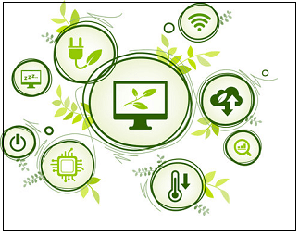
Introduction
also known as sustainable computing,
aims to maximize energy efficiency and minimize environmental impact in the ways computer chips, systems, software are designed and used.
in their working lives, it must deliver the most work for the least energy, typically measured by performance per watt

Slide 3
Approach
Green use: Minimizing the electricity consumption of computers and their peripheral devices and using them in an eco-friendly manner
Green disposal: Repurposing existing equipment or appropriately disposing of, or recycling, unwanted electronic equipment
Green design: Designing energy-efficient computers, servers, printers, projectors and other digital devices
Green manufacturing: Minimizing waste during the manufacturing of computers and other subsystems to reduce the environmental impact of these activities

Slide 4
Objectives
The objectives of green computing are comparable to those of chemical synthesis: decrease the use of dangerous chemicals, maximize energy efficiency throughout the product's lifecycle.
The maximize recyclability or biodegradability of obsolete manufacturing and production garbage.
Green computing is critical for all systems, from personal computers to large-scale information centers.

Slide 5
Benefits
Less usage of energy for producing, using, and disposing of products, which translates into lower carbon dioxide emissions.
Saving energy and resources saves money as a result of more efficient computing and running software.
Enhancing and sophisticating the government policy to encourage recycling and use eco-friendly sources of energy.
Reduce the harmful health effects from the risks that exist in the laptops, such as chemicals known to help cause cancer and other immune reactions in humans.

Slide 6
Disadvantage
The initial implementation is costly.
Frequent change in technology.
Green IT cause more burden to an individual.
Fewer courses and publications related to green computing.

Slide 7
How you can support Green Computing
Turn off your computing device when not in need.
Use an optimal brightness level to conserve power.
Screen saver consumes power so don't use them.
Use sleep mode while not using computer.
Don’t print your draft but review them in your screen.

Slide 8
Any Questions???
Thank You

